Slide 1

Block Ciphers In Parallel

Slide 2
Problem Statement
Is encryption and decryption using block ciphers faster in parallel or sequential?

Slide 3

What Is Encryption
Turning data into something that can't be used
Used to prevent unauthorized use of data
Used in every aspect of computing
Can be heavy on processing power

Slide 4

What is Decryption
Undo encryption
Get back the original information
Can take just as much processing as encryption

Slide 5
Block Ciphers
A method of encryption
Cuts data into equal blocks of data eg. 32 bits = 4 blocks of 8 bits
Takes a block of data and a key
Using key we can encrypt the data to receive a block of same sized data
Using the same key we can decrypt a block of data
Ex. E_{k}(P) = L D_{k}(L) = P
Popular Block Ciphers: AES,DES,TEA

Slide 6
Problem Statement
Is encryption and decryption using block ciphers faster in parallel or sequential?

Slide 7
Design Considerations
Size of problem can be any size
Copy existing block cipher or make own
How large will our blocks be and key
What will our block cipher do
MPI or pthread
Decided pthread and used 4,8,16 threads

Slide 8
Software Used
Using virtual Studio
C++
Thread library
WinSCP
Putty

Slide 9
Compilation Commands
icpc CipherParallel.cpp –o CipherParallel.exe -lpthread
sbatch CipherParallelScript
g++ CipherSerial.cpp -o CipherSerial.exe
sbatch CipherSerialScript

Slide 10
My Custom Block Cipher
16 Characters of original text
Shifting Rows
Uses a string and key of ascii characters
Breaks string into 16 ascii character blocks
If not divisible by 16 pads the end of the string
Needs a 4 ascii character key
Has 3 processes to each block
Has 3 rounds of each process
Exclusive OR
3X
Bit Swaps
16 Characters of encrypted text

Slide 11
Shifting Rows (AES)
0 4 8 12
1 5 9 13
2 6 10 14
3 7 11 15
0 4 8 12
5 9 13 1
10 14 2 6
15 3 7 11
Placing our ASCII characters in a 4X4
Shift each row, to the left, by incrementing amounts starting at 0

Slide 12
Exclusive Or Cipher
Using the 4 ascii character key
Performs a XOR on all 16 characters in sets of 4
EX. Key = "ADHG"
0^A 4^A 8^A 12^A
1^D 5^D 9^D 13^D
2^H 6^H 10^H 14^H
3^G 7^G 11^G 15^G

Slide 13
Bit Swaps (DES)
Each ascii character comprised of bits
Break each character down into bits and swaps them around
Swaps bit 1,4 and 2,3
7
1 1 0 1 1 1

Slide 14
Decrypting Cipher
16 Characters of encrypted text
Swap Bits Back
Do everything in reverse
Order of processes in reverse
Processes undo work done
Need same key
Exclusive OR
3X
Shift Rows Back
16 Characters of original text

Slide 15
INPUT FROM FILE:
Hello I am checking to see if both projects make sure that they have the same decrypted message and encrypted message
==============================
INPUT ENCRYPTED:
:df<:57 s(3%>*$sd5+/4#(.=;9:df+27/371f0.d/,90$a:d"( #, s/f%9.4%s%/a2,+a9>/( /0*7f+!-5,:#f :,$ s.4(/)/&/,/)15f2SDF( DFAS%FASD?
==============================
INPUT DECRYPTED:
Hello I am checking to see if both projects make sure that they have the same decrypted message and encrypted message

Slide 16
How To Make Parallel
Used posix threads
MPI has too much communication or too much padding
Give each block to one thread
If a thread completes block give another if all threads used
All threads can modify shared string no mutex needed
No thread modifies same thing

Slide 17
Results(stampede)
Encrypt Runtime(seconds)
Threads | Amount of Characters
 | 2000 | 20000 | 200000
16 | 0.01 | 0.14 | 1.52
8 | 0.01 | 0.15 | 1.55
4 | 0.01 | 0.17 | 1.54
1 | 0.01 | 0.08 | 0.82
Decrypt Runtime(seconds)
Threads | Amount of Characters
 | 2000 | 20000 | 200000
16 | 0.01 | 0.15 | 1.51
8 | 0.01 | 0.14 | 1.54
4 | 0.01 | 0.16 | 1.55
1 | 0.01 | 0.08 | 0.82

Slide 18
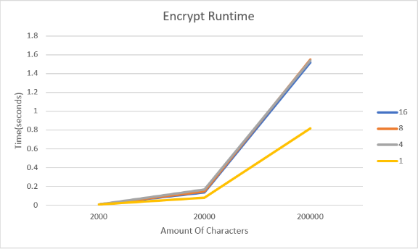

Slide 19
Encrypt Speedup |  |  |  |  | Decrypt Speedup
Threads | Amount of Characters |  |  |  | Threads | Amount of Characters
 | 2000 | 20000 | 200000 |  |  | 2000 | 20000 | 200000
16 | 1 | 0.571428 | 0.53947 |  | 16 | 1 | 0.533333 | 0.543046
8 | 1 | 0.533333 | 0.529032 |  | 8 | 1 | 0.571428 | 0.532467
4 | 1 | 0.470588 | 0.532467 |  | 4 | 1 | 0.5 | 0.529032
1 | 1 | 1 | 1 |  | 1 | 1 | 1 | 1

Slide 20
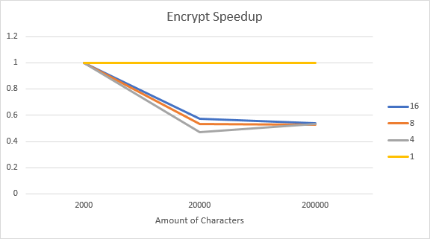

Slide 21
Encrypt Efficiency |  |  |  |  | Decrypt Efficiency
Threads | Amount of Characters |  |  |  | Threads | Amount of Characters
 | 2000 | 20000 | 200000 |  |  | 2000 | 20000 | 200000
16 | 0.0625 | 0.03571 | 0.03371 |  | 16 | 0.0625 | 0.033333 | 0.03394
8 | 0.125 | 0.06666 | 0.06612 |  | 8 | 0.125 | 0.07142 | 0.06655
4 | 0.25 | 0.11764 | 0.13311 |  | 4 | 0.25 | 0.125 | 0.13225
1 | 1 | 1 | 1 |  | 1 | 1 | 1 | 1

Slide 22
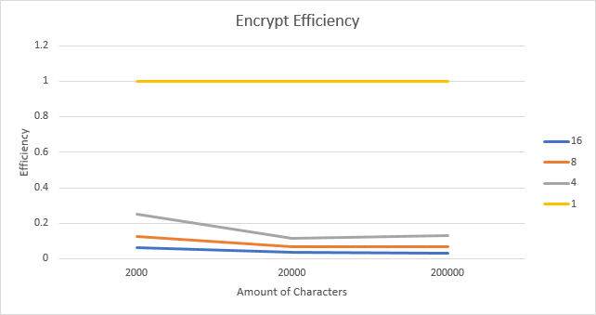

Slide 23
Results(local hardware)
Encrypt Runtime(seconds) |  |  |  |  | Decrypt Runtime(seconds)
Threads | Amount of Characters |  |  |  | Threads | Amount of Characters
 | 2000 | 20000 | 200000 |  |  | 2000 | 20000 | 200000
16 | 0.017 | 0.17 | 1.539 |  | 16 | 0.016 | 0.165 | 1.586
8 | 0.02 | 0.191 | 1.748 |  | 8 | 0.021 | 0.187 | 1.712
4 | 0.026 | 0.212 | 2.104 |  | 4 | 0.022 | 0.226 | 2.125
1 | 0.025 | 0.224 | 2.215 |  | 1 | 0.024 | 0.225 | 2.255

Slide 24
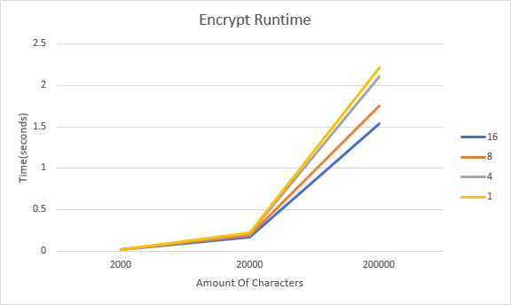

Slide 25
Encrypt Speedup |  |  |  |  | Decrypt Speedup
Threads | Amount of Characters |  |  |  | Threads | Amount of Characters
 | 2000 | 20000 | 200000 |  |  | 2000 | 20000 | 200000
16 | 1.47058 | 1.31764 | 1.43924 |  | 16 | 1.5 | 1.36363 | 1.42181
8 | 1.25 | 1.17277 | 1.26716 |  | 8 | 1.14285 | 1.20320 | 1.31717
4 | 0.96153 | 1.05660 | 1.05275 |  | 4 | 1.09090 | 0.99557 | 1.06117
1 | 1 | 1 | 1 |  | 1 | 1 | 1 | 1

Slide 26
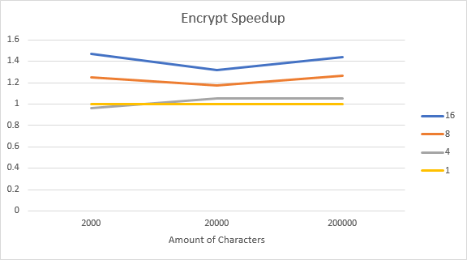

Slide 27
Encrypt Efficiency |  |  |  |  | Decrypt Efficiency
Threads | Amount of Characters |  |  |  | Threads | Amount of Characters
 | 2000 | 20000 | 200000 |  |  | 2000 | 20000 | 200000
16 | 0.09191 | 0.08235 | 0.08995 |  | 16 | 0.09375 | 0.08522 | 0.08886
8 | 0.15625 | 0.14659 | 0.15839 |  | 8 | 0.14285 | 0.15042 | 0.16464
4 | 0.24038 | 0.26415 | 0.26318 |  | 4 | 0.27272 | 0.24889 | 0.26529
1 | 1 | 1 | 1 |  | 1 | 1 | 1 | 1

Slide 28
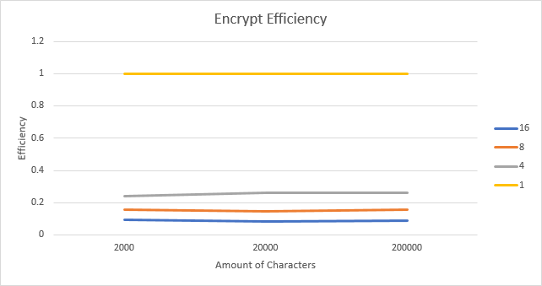

Slide 29
Biggest Obstacles
Trying to use pthread library in visual studio
Spending a whole day attempting to find why my stampede results are so different

Slide 30
Conclusion
Serial beats Parallel in testing on stampede
Opposite result on local hardware
Lean more towards local hardware as more threads has effect
Efficiency low in both cases

